Slide 1
Constraint Satisfaction Problems (CSPs)

Slide 2
Outline
What is a CSP
Backtracking for CSP
Local search for CSPs

Slide 3
Key issue: So far, we have treated nodes in search trees as “black boxes,” only looked inside to check whether the node is a goal state.
In CSPs, we want to “look inside the nodes” and exploit problem structure during the search. Sometimes, reasoning or inference (“propagation techniques”) will led us find solutions without any search!

Slide 4
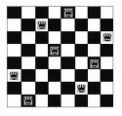
Motivational Example:
8-Queens
Usual goal:
place 8 non-attacking
queens.
Already shown effectiveness of local search.

Slide 5
Generic (DFS/BFS) search
Is this how you would
program this problem?
Node is a (partial) state of the board
Action: “place a queen on board”
Goal test: are there 8 non-attacking queens?
How many placements of 8 queens will be considered?
The DFS/BFS tree will enumerate up to
64⁸ combinations (assume limit depth to 8).
64^8 = 2^48 = 2.8 x 10^14
Note redundancy: Q1 in (1,3), Q2 in (2,7) …
vs. Q1 in (2,7), Q2 in (1,3) …

Slide 6
Alternative: Use “factored representation.”
Factoring refers to “splitting things into smaller parts.”
State has internal structure.
1) Here, a set of 8 variables.
x_1, x_2, … x_8.
2) Each with domain {1,…8}, the
possible variable values.
3) A set of constraints:
e.g. no two vars can be assigned
the same value. (Why?)
Each variable gives the position
of a queen in a row.
Number of board states to explore:
“only” 8⁸ = 16.7 x 10^6 combinations.
Set of vars, set of possible values for each vars
& set of constraints defines a CSP.

Slide 7
Set of vars, set of possible values for each vars & set of constraints defines a CSP.
A solution to the CSP is an assignment of values to the variables so that all constraints are satisfied (no “violated constraints.”)
A CSP is inconsistent if no such solution exists. Eg try to place 9 non-attacking queens on an 8x8 board.
Hmm. Can a search program figure out that you can’t place 101 queens on 100x100 board? Not so easy! Most search approaches can’t. Need much more clever reasoning, instead of just search. (Need to use Pigeon Hole principle.)
Aside: Factored representation does not even allow one to ask the question. Knowledge is build in.)
Alternative question: With N queens is there a solution with queen in bottom right hand corner on a N x N board?

Slide 8
How do we search for a solution?
Start with empty variable assignment (no vars assigned). Then, build up partial assignments until all vars assigned.
Action: “assign a variable a value.”
Goal test: “all vars assigned and no constraint violation.”
What is the search space? (n vars, each with d possible values)
Top level branching: n . d
Next branching: (n-1) . d
Next branching: (n-2) . d
…
Bottom level: d
(one var remains to be set)
So, tree with n! d^n leaves.
Hmm. But “only” n^d distinct value assignments! Different var ordering can lead to the same assignment! Wasteful…
Just “fix” a variable ordering:
Backtrack search.
Check only n^d full var-value assignments.

Slide 9
Constraint Satisfaction Problems
What is a CSP?
  Finite set of variables X₁, X₂, …, X_{n}
  Nonempty domain of possible values for each variable
  D₁, D₂, …, D_{n}
  Finite set of constraints C₁, C₂, …, C_{m}
    Each constraint C_{i} limits the values that variables can take,
    e.g., X₁ ≠ X₂
  Each constraint C_{i} is a pair <scope, relation>
    Scope = Tuple of variables that participate in the constraint.
    Relation = List of allowed combinations of variable values.
    May be an explicit list of allowed combinations.
    May be an abstract relation allowing membership testing and listing.

Slide 10
8-Queens
Variables: Queens, one per column
  Q1, Q2, …, Q8
Domains: row placement, {1,2,…,8}
Constraints:
Qi != Qj (j != i)
|Qi – Qj| != |i – j|

Slide 11
Other problems
[Satisfiability]
Scheduling (Hubble telescope; class schedule; car assembly)
Design (hardware configuration, VLSI design)

Slide 12
CSPs --- what is a solution?
A state is an assignment of values to some or all variables.
  An assignment is complete when every variable has a value.
  An assignment is partial when some variables have no values.
Consistent assignment
  assignment does not violate the constraints
A solution to a CSP is a complete and consistent assignment.
Some CSPs require a solution that maximizes an objective function.

Slide 13
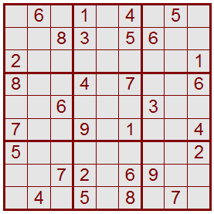
Sudoku as a Constraint Satisfaction Problem (CSP)
1 2 3 4 5 6 7 8 9
A
B
C
D
E
F
G
H
I
Variables: 81 variables
  A1, A2, A3, …, I7, I8, I9
  Letters index rows, top to bottom
  Digits index columns, left to right
Domains: The nine positive digits
  A1 ∈ {1, 2, 3, 4, 5, 6, 7, 8, 9}
  Etc.
Constraints: 27 Alldiff constraints
  Alldiff(A1, A2, A3, A4, A5, A6, A7, A8, A9)
  Etc.
[Why constraint satisfaction?]

Slide 14
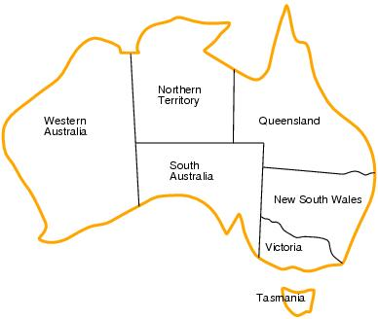
CSP example: map coloring
Variables: WA, NT, Q, NSW, V, SA, T
Domains: D_{i}={red,green,blue}
Constraints:adjacent regions must have different colors.
    E.g. WA ≠ NT

Slide 15
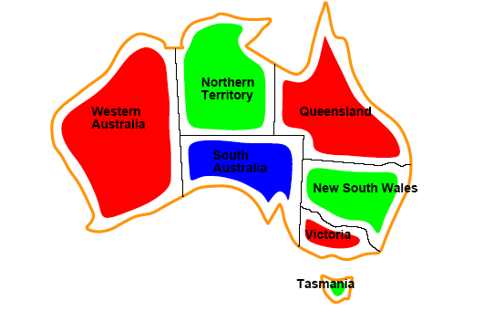
CSP example: map coloring
Solutions are assignments satisfying all constraints, e.g.
{WA=red,NT=green,Q=red,NSW=green,V=red,SA=blue,T=green}

Slide 16
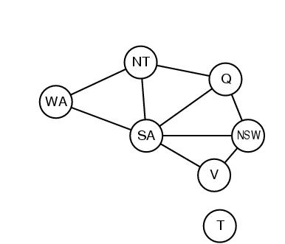
Constraint graphs
Constraint graph:
  nodes are variables
  arcs are binary constraints
Graph can be used to simplify search
e.g. Tasmania is an independent subproblem

Slide 17
Varieties of constraints
Unary constraints involve a single variable.
  e.g. SA ≠ green
Binary constraints involve pairs of variables.
  e.g. SA ≠ WA
Higher-order constraints involve 3 or more variables.
  Professors A, B,and C cannot be on a committee together
  Can always be represented by multiple binary constraints
Preference (soft constraints)
  e.g. red is better than green often can be represented by a cost for each variable assignment
  combination of optimization with CSPs

Slide 18
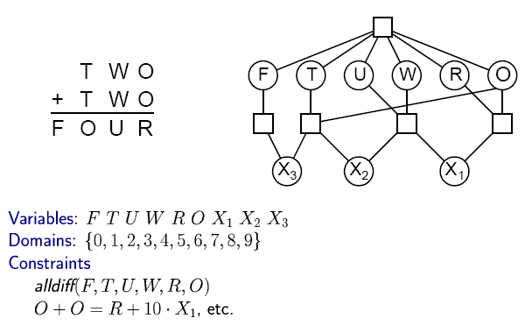

CSP Example: Cryptharithmetic puzzle

Slide 19
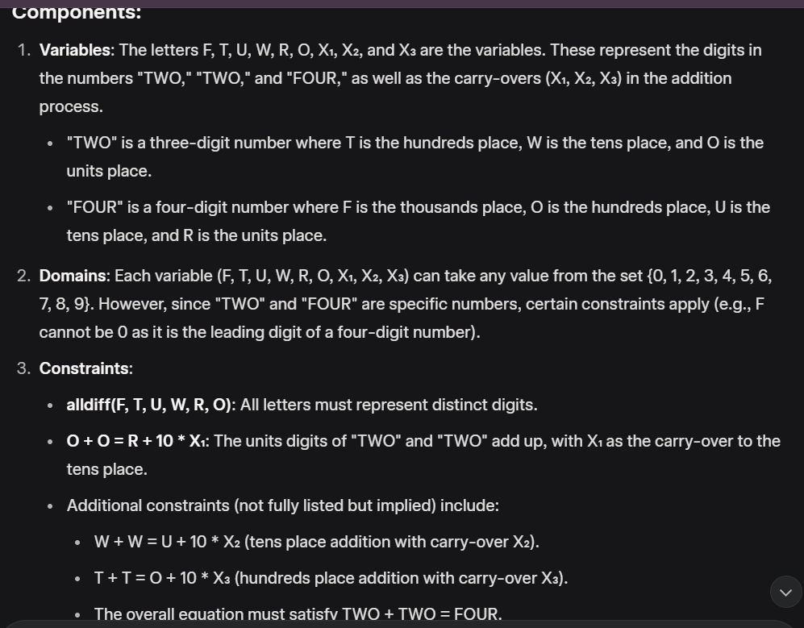
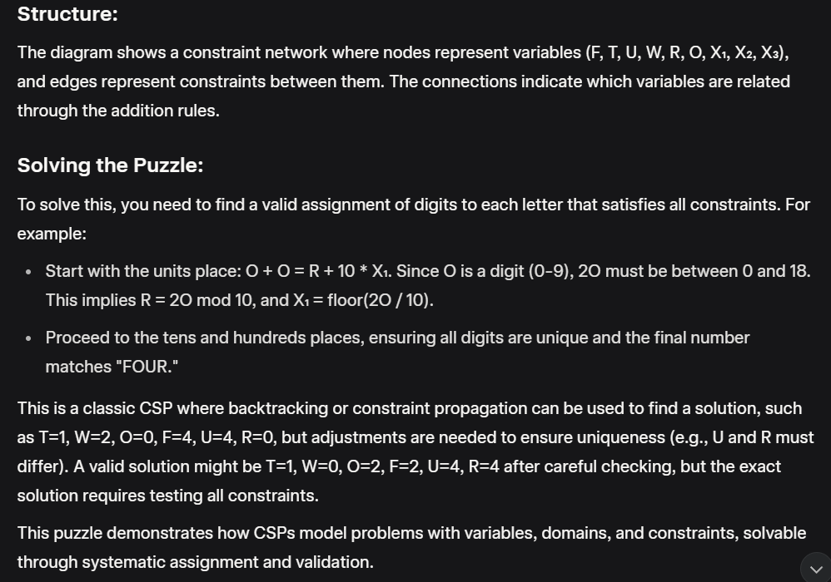
CSP Example: Cryptharithmetic puzzle

Slide 20
CSP as a standard search problem
A CSP can easily be expressed as a standard search problem.
Incremental formulation
  Initial State: the empty assignment {}
  Successor function: Assign a value to an unassigned variable provided that it does not violate a constraint
  Goal test: the current assignment is complete
    (by construction it is consistent)
  Path cost: constant cost for every step (not really relevant)
Can also use complete-state formulation
  Local search techniques (Chapter 4)

Slide 21
CSP as a standard search problem
Solution is found at depth n (if there are n variables).
Consider using BrFS
  Number of children of the start node is nd
  Each of those has (n-1)d
  ….
end up with n!d^{n} leafs even though there are only d^{n} complete assignments!

Slide 22
Commutativity
CSPs are commutative.
  The order of any given set of actions has no effect on the outcome.
  Another Example: choose colors for Australian territories one at a time
    [WA=red then NT=green] same as [NT=green then WA=red]
All CSP search algorithms can generate successors by considering assignments for only a single variable on each level
  ⇒ there are d^{n} leaves
  (will need to figure out later which variable to assign a value to at each node)

Slide 23
Backtracking search
Depth-first searchin the context of CSP is also called “backtracking”
Chooses values for one variable at a time and backtracks when a variable has no legal values left to assign.
Nice: we have a standard representation. No need for a domain-specific initial state, successor function, or goal test.

Slide 24
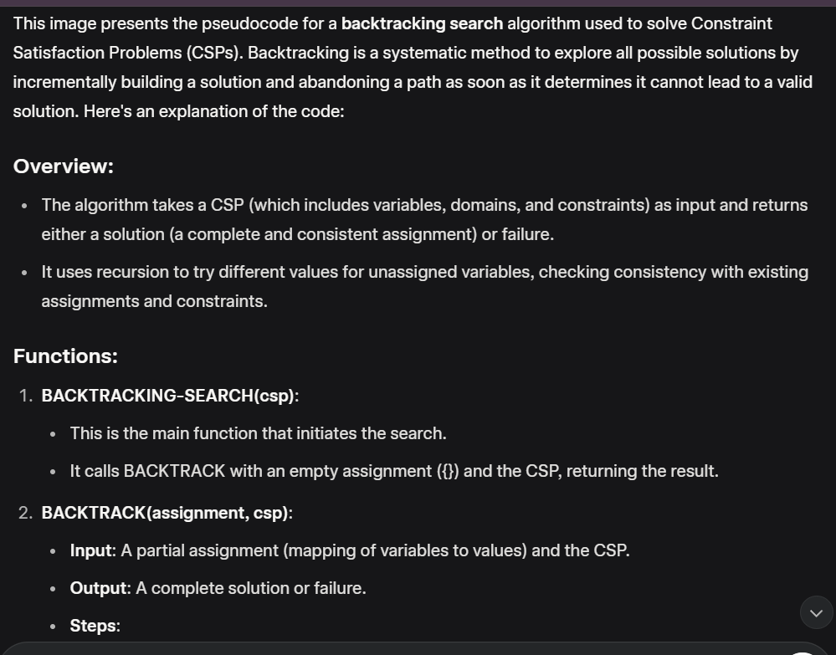
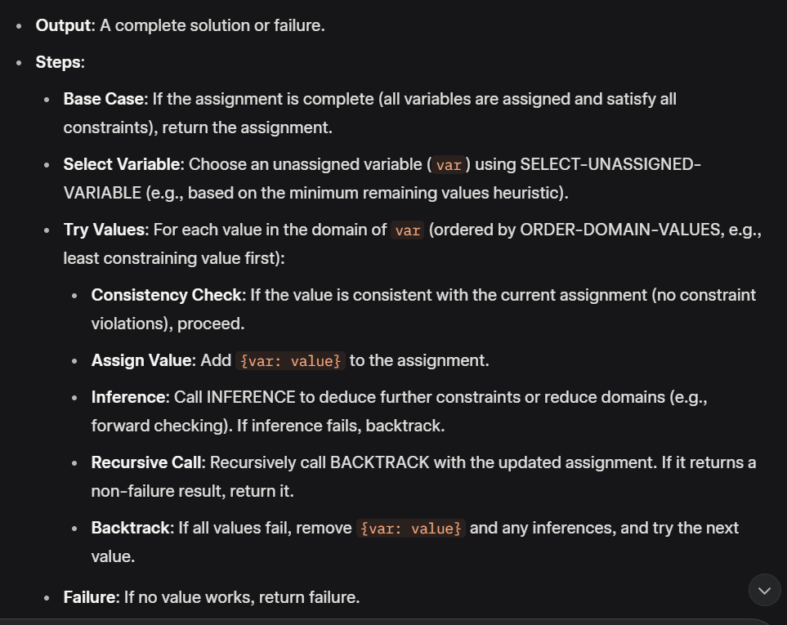
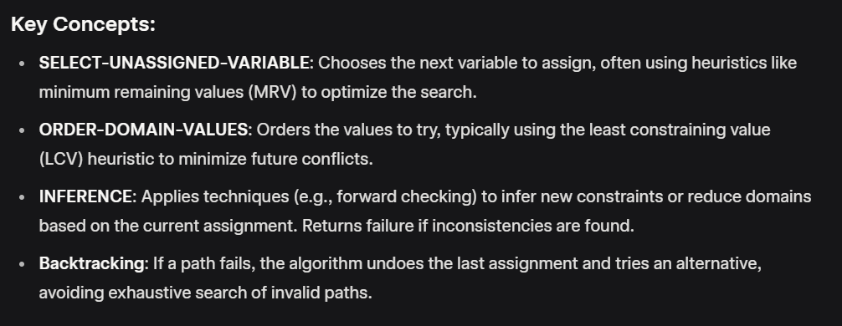
Backtracking search
function BACKTRACKING-SEARCH(csp) return a solution or failure
return BACKTRACK({} , csp)
function BACKTRACK(assignment, csp) return a solution or failure
if assignment is complete then return assignment
var ← SELECT-UNASSIGNED-VARIABLE(csp,assignment)
for each value in ORDER-DOMAIN-VALUES(var, assignment, csp) do
if value is consistent with assignment then
add {var=value} to assignment
inferences ← INFERENCE(csp,assignment)
if inferences != failure
add inferences to assignment
result ← BACTRACK(assignment, csp)
if result ≠ failure then return result
remove {var=value} and inferences from assignment (if you added it)
return failure

Slide 25
Improving CSP efficiency
Previous improvements on uninformed search
  → introduce heuristics
For CSPS, general-purpose methods can give large gains in speed, e.g.,
  Which variable should be assigned next?
  In what order should its values be tried?
  Can we detect inevitable failure early?

Slide 26
Backtracking search
SELECT-UNASSIGNED-VARIABLE
Minimum Remaining Values (MRV)
  Most constrained variable
  Most likely to fail soon (so prunes pointless searches)
If a tie (such as choosing the start state), choose the variable involved in the most constraints (degree heuristic) E.g., in the map example, SA adjacent to the most states.
  Reduces branching factor, since fewer legal successors of that node

Slide 27
CSP example: map coloring
Solutions are assignments satisfying all constraints, e.g.
{WA=red,NT=green,Q=red,NSW=green,V=red,SA=blue,T=green}

Slide 28
Backtracking search
ORDER-DOMAIN-VALUES
  Least Constraining Value
  Rules out the fewest choices for the variables it is in constraints with
  Leave the maximum flexibility
  You’ve chosen the variable, now let’s make the most of it

Slide 29

Minimum remaining values (MRV)
var ← SELECT-UNASSIGNED-VARIABLE(assignment,csp)
  Before the assignment to the rightmost state: one region has one remaining; one region has two; three regions have three. Choose the region with only one remaining

Slide 30

Degree heuristic for resolving ties among variables
Degree heuristic can be useful as a tie breaker.
Before the assignment to the rightmost state, WA and Q have the same number of remaining values ({R}). So, choose the one adjacent to the most states. This will cut down on the number of legal successor states to it.

Slide 31
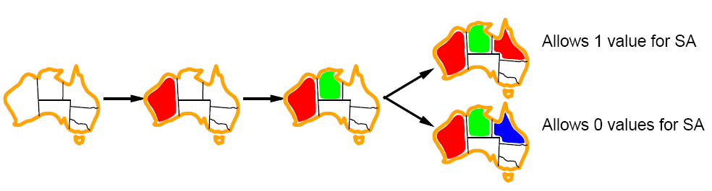
Least constraining value for value-ordering
Least constraining value heuristic
Heuristic Rule: given a variable choose the least constraining value
  leaves the maximum flexibility for subsequent variable assignments

Slide 32
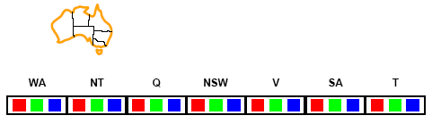
Forward checking (INFERENCE)
Can we detect inevitable failure early?
  And avoid it later?
Forward checking idea: keep track of remaining legal values for unassigned variables.
Terminate search when any variable has no legal values.

Slide 33
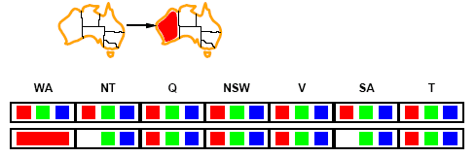
Forward checking
Assign {WA=red}
Effects on other variables connected by constraints to WA
  NT can no longer be red
  SA can no longer be red
Note: this example is not using MRV; if it were, we would choose NT or SA next. But, we will choose Q next. This example is from the text. It shows the example here, then talks through what would happen if we had used MRV.

Slide 34
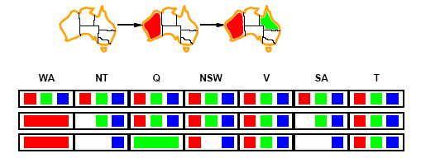
Forward checking
Assign {Q=green}
Effects on other variables connected by constraints with WA
  NT can no longer be green
  NSW can no longer be green
  SA can no longer be green

Slide 35
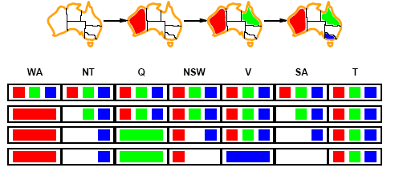
Forward checking
Assign {V=blue}
Effects on other variables connected by constraints with WA
  NSW can no longer be blue
  SA is empty
Forward Checking has detected that partial assignment is inconsistent with the constraints and backtracking can occur.

Slide 36
Backtracking search
function BACKTRACKING-SEARCH(csp) return a solution or failure
return BACKTRACK({} , csp)
function BACKTRACK(assignment, csp) return a solution or failure
if assignment is complete then return assignment
var ← SELECT-UNASSIGNED-VARIABLE(csp,assignment)
for each value in ORDER-DOMAIN-VALUES(var, assignment, csp) do
if value is consistent with assignment then
add {var=value} to assignment
inferences ← INFERENCE(csp,assignment)
if inferences != failure
add inferences to assignment
result ← BACTRACK(assignment, csp)
if result ≠ failure then return result
remove {var=value} and inferences from assignment (if you added it)
return failure

Slide 37
Example: 4-Queens Problem
X1
{1,2,3,4}
X2
{1,2,3,4}
1
2
3
4
1
2
3
4
X3
{1,2,3,4}
X4
{1,2,3,4}

Slide 38
Example: 4-Queens Problem
X1
{1,2,3,4}
X2
{1,2,3,4}
1
2
3
4
1
2
3
4
X3
{1,2,3,4}
X4
{1,2,3,4}

Slide 39
Example: 4-Queens Problem
X1
{1,2,3,4}
X2
{ , ,3,4}
1
2
3
4
1
2
3
4
X3
{ ,2, ,4}
X4
{ ,2,3, }

Slide 40
Example: 4-Queens Problem
X1
{1, , , }
X2
{ , ,3,4}
1
2
3
4
1
2
3
4
X3
{ , , , }
X4
{ ,2, , }

Slide 41
Example: 4-Queens Problem
X1
{1,2,3,4}
X2
{ , ,3,4}
1
2
3
4
1
2
3
4
X3
{ ,2, ,4}
X4
{ ,2,3, }

Slide 42
Example: 4-Queens Problem
X1
{1,2,3,4}
X2
{ , ,3,4}
1
2
3
4
1
2
3
4
X3
{ ,2, , }
X4
{ ,2,3, }

Slide 43
Example: 4-Queens Problem
X1
{1,2, , }
X2
{ , ,3,4}
1
2
3
4
1
2
3
4
X3
{ ,2, , }
X4
{ , ,3, }

Slide 44
Example: 4-Queens Problem
X1
{1,2, , }
X2
{ , ,3,4}
1
2
3
4
1
2
3
4
X3
{ ,2, , }
X4
{ , ,3, }

Slide 45
Example: 4-Queens Problem
X1
{1, , , }
X2
{ , , ,4}
1
2
3
4
1
2
3
4
X3
{ ,2, , }
X4
{ , , , }

Slide 46
Solving CSPs (backtrack) with combination of heuristics plus forward checking is more efficient than either approach alone
But Forward Checking does not see all inconsistencies
Consider our map coloring search, after we have assigned WA=red and Q=green

Slide 47
Forward checking
WA=Red; Q=green
Forward checking gives us the third row
At this point, we can see that this is inconsistent, since NT and SA are forced to be blue, yet they are adjacent. Forward checking doesn’t see this, and proceeds onward in the search from this state (as we saw earlier)

Slide 48
Constraint propagation
Forward checking (FC) is in effect eliminating parts of the search space
Constraint propagation goes further than FC by repeatedly enforcing constraints locally
  Needs to be faster than actually searching to be effective
Arc-consistency (AC) is a systematic procedure for constraint propagation

Slide 49
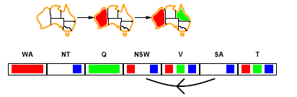
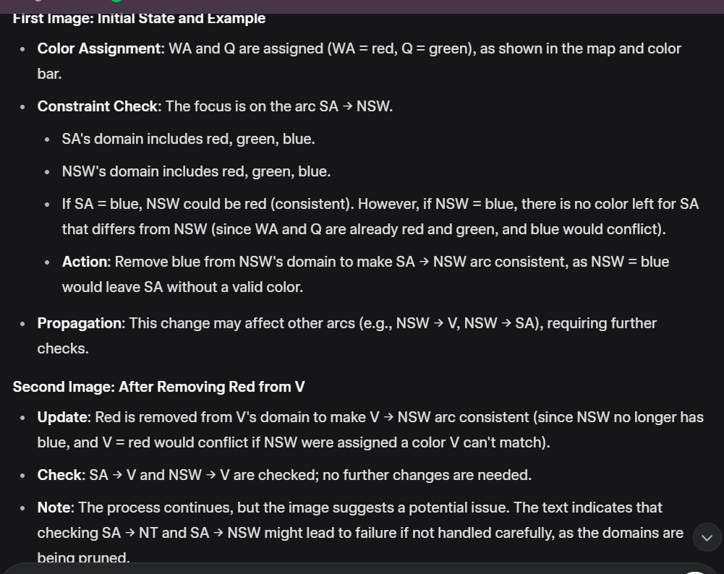
Arc consistency
An Arc X → Y is consistent if
for every value x of X there is some value y consistent with x
Consider state of search after WA and Q are assigned:
SA → NSW is consistent: if SA=blue NSW could be =red

Slide 50
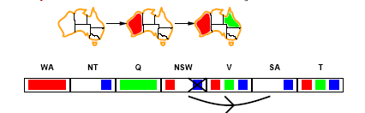
Arc consistency
X → Y is consistent if for every value x of X there is some value y consistent with x
We will try to make the arc consistent by deleting x’s for which there is no y (and then check to see if anything else has been affected – algorithm is in a few slides)
NSW → SA: if NSW=red SA could be =blue
But, if NSW=blue, there is no color for SA.
So, remove blue from the domain of NSW
Propagate the constraint: need to check Q → NSW SA → NSW V → NSW
If we remove values from any of Q, SA, or V’s domains, we will need to check THEIR neighbors
[continue process on next slide and board]

Slide 51
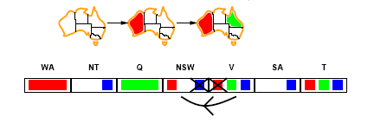
Arc consistency
After removing red from domain of V to make V → NSW arc consistent
SA → V, NSW → V check out; no changes
Check the remaining arcs: most check out, until we check SA → NT, NT → SA. Whichever is checked first will result in failure.

Slide 52
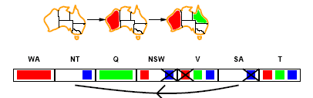
Arc consistency
SA → NT is not consistent
  and cannot be made consistent
Arc consistency detects failure earlier than FC
This process was all in one call to the INFERENCE function right after we assigned Q=green. Forward checking proceeded in the search, assigning a value to V.

Slide 53
Arc consistency checking
AC must be run until no inconsistency remains
Trade-off
  Requires some overhead to do, but generally more effective than direct search
  In effect it can eliminate large (inconsistent) parts of the state space more effectively than search can
Need a systematic method for arc-checking
  If X loses a value, neighbors of X need to be rechecked:
i.e. incoming arcs can become inconsistent again
(outgoing arcs will stay consistent).

Slide 54
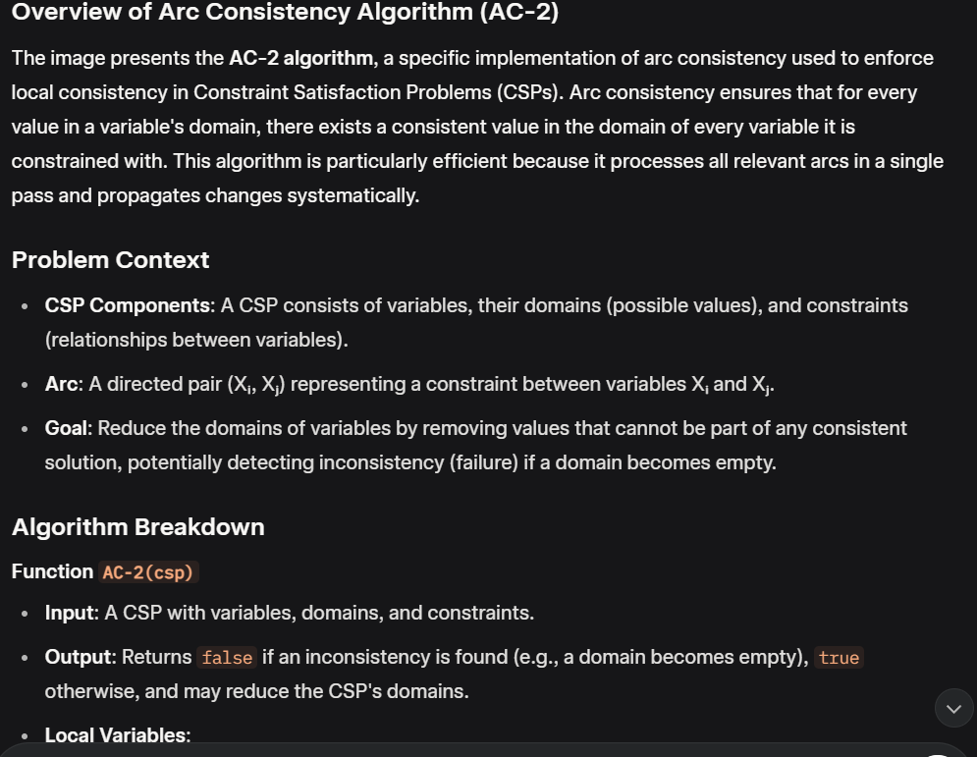
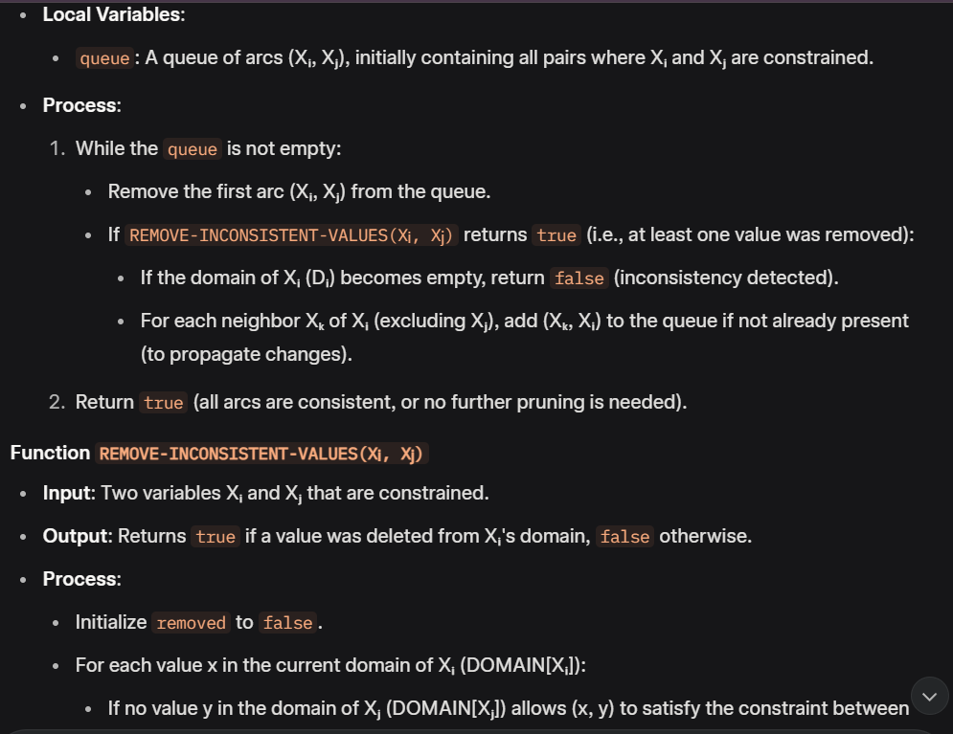

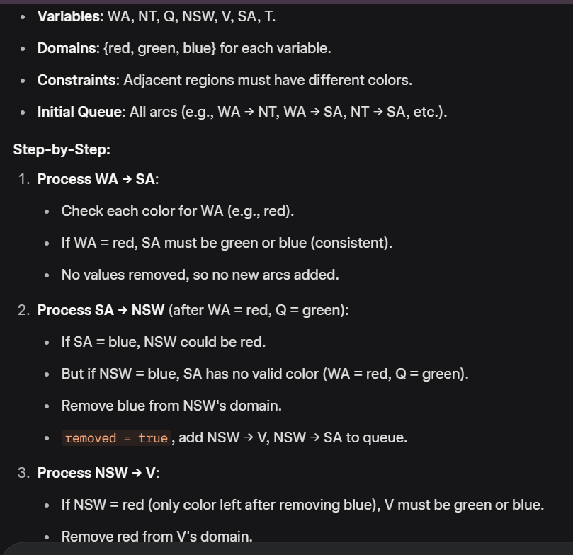
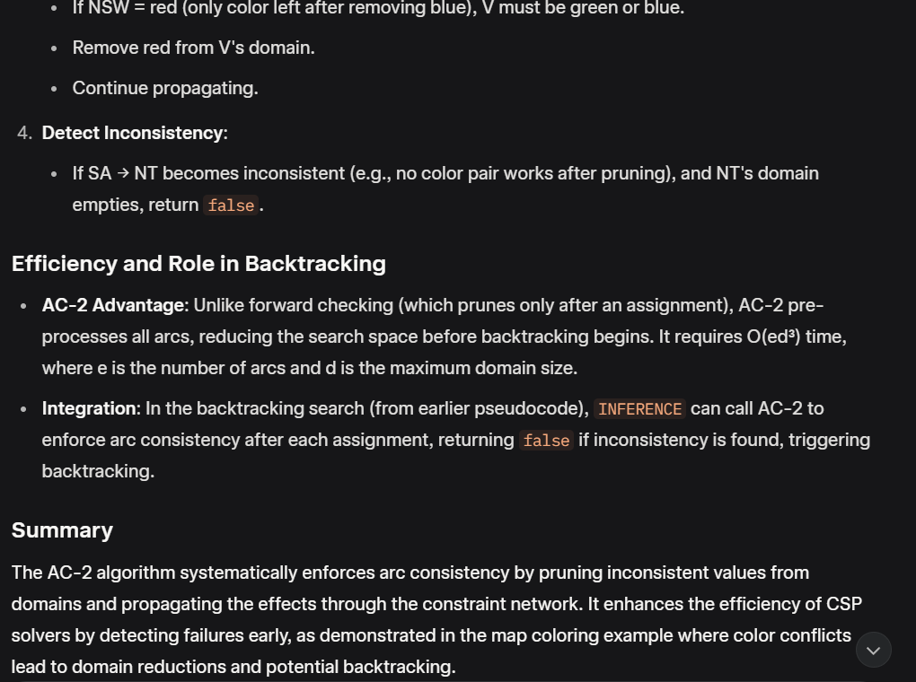
Arc consistency algorithm (AC-2)
function AC-2(csp) returns false if inconsistency found, else true, may reduce csp domains
local variables: queue, a queue of arcs, initially all the arcs in csp
/* initial queue must contain both (X_{i}, X_{j}) and (X_{j}, X_{i}) */
while queue is not empty do
(X_{i}, X_{j}) ← REMOVE-FIRST(queue)
if REMOVE-INCONSISTENT-VALUES(X_{i}, X_{j}) then
if size of D_{i} = 0 then return false
for each X_{k} in NEIGHBORS[X_{i}] − {X_{j}} do
add (X_{k}, X_{i}) to queue if not already there
return true
function REMOVE-INCONSISTENT-VALUES(X_{i}, X_{j}) returns true iff we delete a
value from the domain of X_{i}
removed ← false
for each x in DOMAIN[X_{i}] do
if no value y in DOMAIN[X_{j}] allows (x,y) to satisfy the constraints
between X_{i} and X_{j}
then delete x from DOMAIN[X_{i}]; removed ← true
return removed

Slide 55
Complexity of AC-2
A binary CSP has at most n² arcs
Each arc can be inserted in the queue d times (worst case)
  (X, Y): only d values of X to delete
Consistency of an arc can be checked in O(d²) time (d values of the first * d values of the second)
Complexity is O(n² d³)
Although substantially more expensive than Forward Checking, Arc Consistency is usually worthwhile.

Slide 56
Trade-offs
Running stronger consistency checks…
  Takes more time
  But will reduce branching factor and detect more inconsistent partial assignments
  No “free lunch”
    In worst case n-consistency takes exponential time
Generally helpful to enforce 2-Consistency (Arc Consistency)
Sometimes helpful to enforce 3-Consistency
Higher levels may take more time to enforce than they save.

Slide 57
Local search for CSPs
Use complete-state representation
  Initial state = all variables assigned values
  Successor states = change a value
For CSPs
  allow states with unsatisfied constraints (unlike backtracking)
  operators reassign variable values
  hill-climbing with n-queens is an example (we saw in earlier notes)
Variable selection: randomly select any conflicted variable
Value selection: min-conflicts heuristic
  Select new value that results in a minimum number of conflicts with the other variables

Slide 58
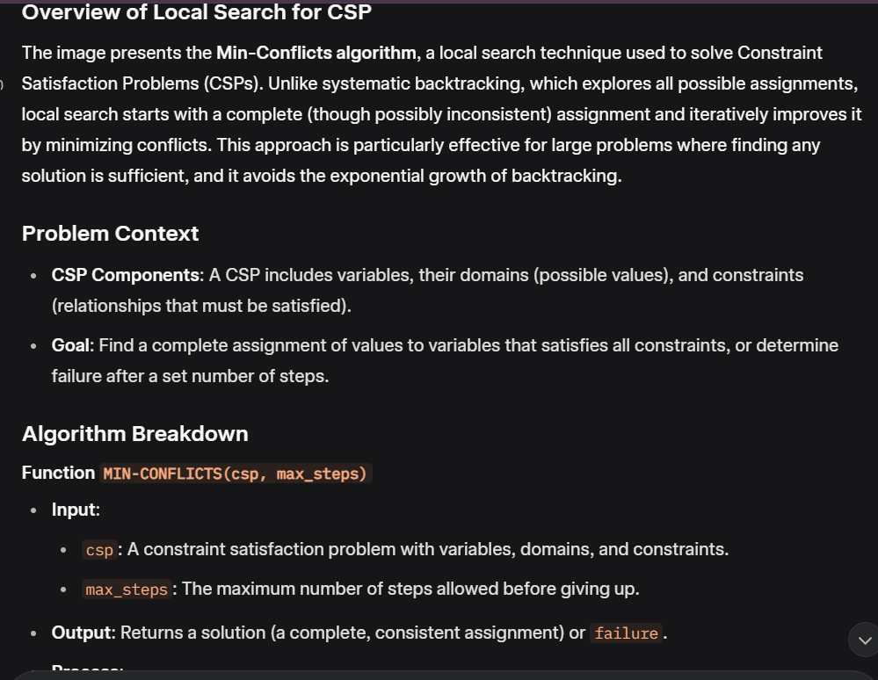
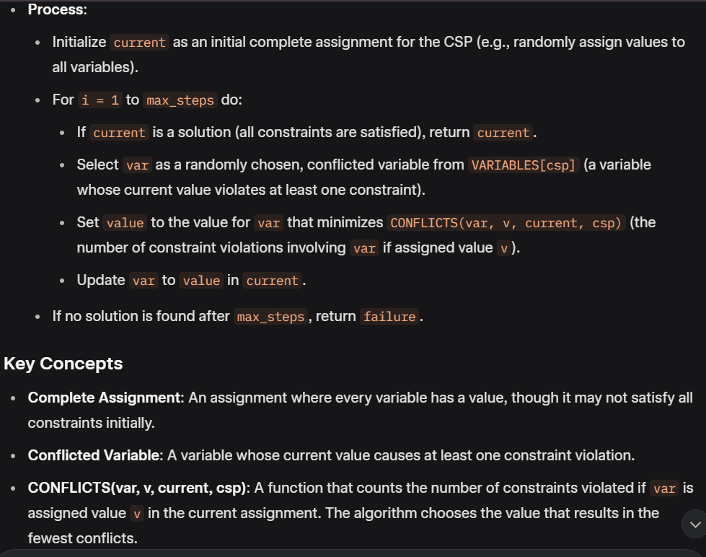
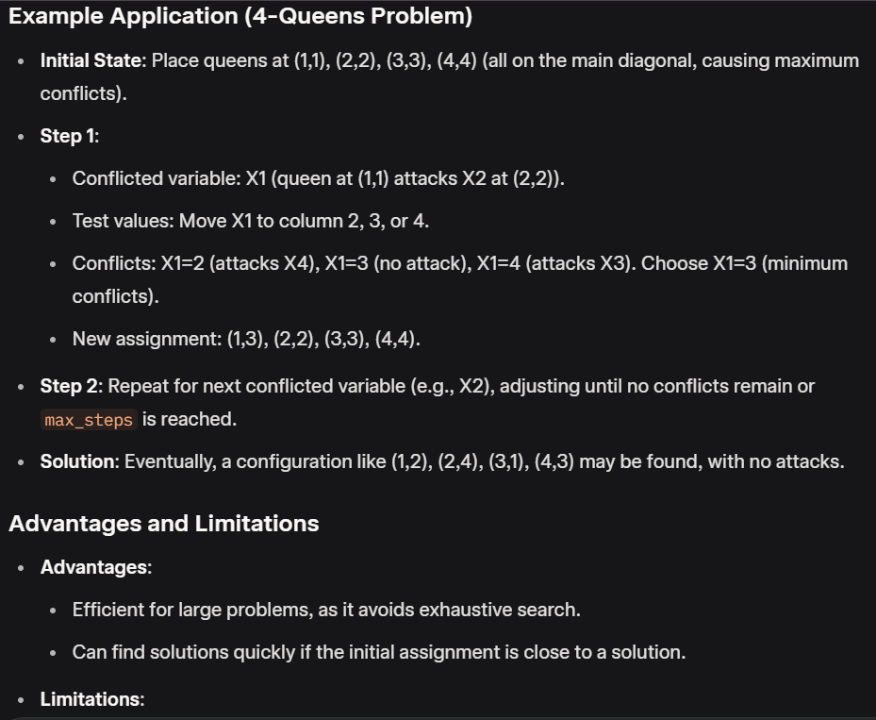
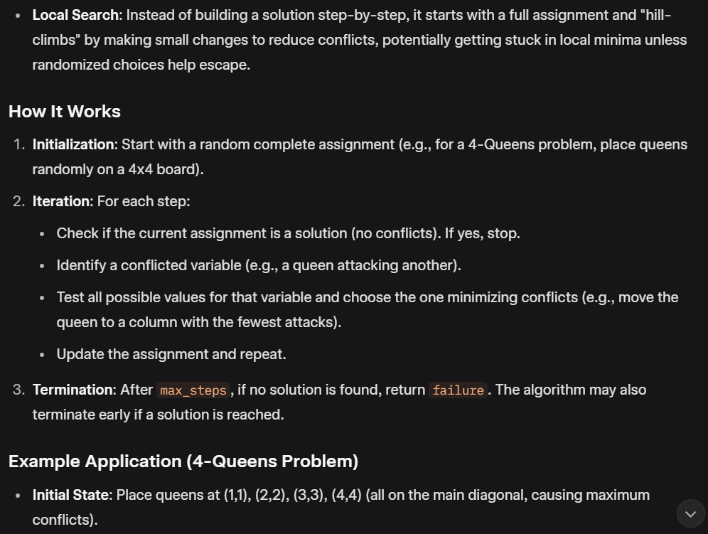
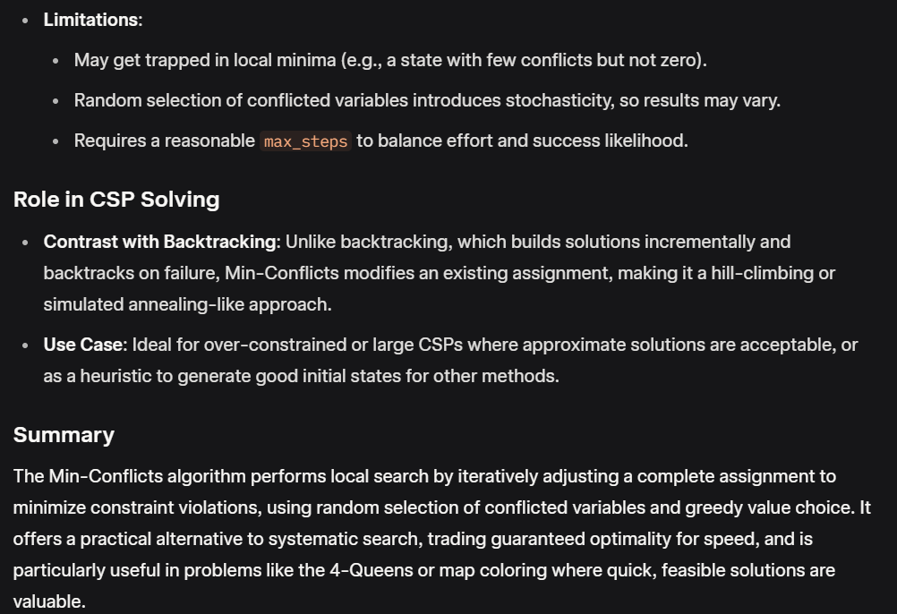
Local search for CSP
function MIN-CONFLICTS(csp, max_steps) return solution or failure
inputs: csp, a constraint satisfaction problem
max_steps, the number of steps allowed before giving up
current ← an initial complete assignment for csp
for i = 1 to max_steps do
if current is a solution for csp then return current
var ← a randomly chosen, conflicted variable from VARIABLES[csp]
value ← the value v for var that minimize CONFLICTS(var,v,current,csp)
set var = value in current
return failure

Slide 59
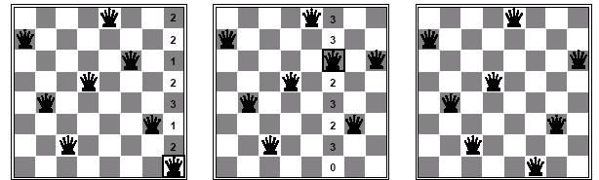
Min-conflicts example
A two-step solution for an 8-queens problem using min-conflicts heuristic
At each stage a queen is chosen for reassignment in its column
The algorithm moves the queen to the min-conflict square, breaking ties randomly.

Slide 60
Advantages of local search
Local search can be particularly useful in an online setting
  Airline schedule example
    E.g., mechanical problems require that a plane is taken out of service
    Can locally search for another “close” solution in state-space
    Much better (and faster) in practice than finding an entirely new schedule
The runtime of min-conflicts is roughly independent of problem size for the 8-queens (observation in the 1990’s that gave rise to much research).
  Can solve the millions-queen problem in roughly 50 steps.
  Why?
    n-queens is easy for local search because of the relatively high density of solutions in state-space

Slide 61
Summary
CSPs
  special kind of problem: states defined by values of a fixed set of variables, goal test defined by constraints on variable values
Backtracking=depth-first search with one variable assigned per level
Heuristics
  Variable ordering and value selection heuristics help significantly
Constraint propagation does additional work to constrain values and detect inconsistencies
  Works effectively when combined with heuristics
Iterative min-conflicts is often effective in practice.

Slide 62
Wrapup: You Will Be Expected to Know
Basic definitions (section 6.1)
Arc consistency (6.2.2); Sudoku example (6.2.6)
Backtracking search (6.3)
Variable and value ordering: minimum-remaining values, degree heuristic, least-constraining-value (6.3.1)
Forward checking (6.3.2)
Local search for CSPs: min-conflict heuristic (6.4)

